Slide 1
Multivariate Data Analysis and Process Modeling
Linear Regression
Essential Linear Algebra
Logistic Regression
Basic Multivariate data calculations and statistical distance
Principal Component Analysis
Neural Networks
Discriminant Analysis
For Design of Experiments pl. see link https://nptel.ac.in/courses/103106112

Slide 2
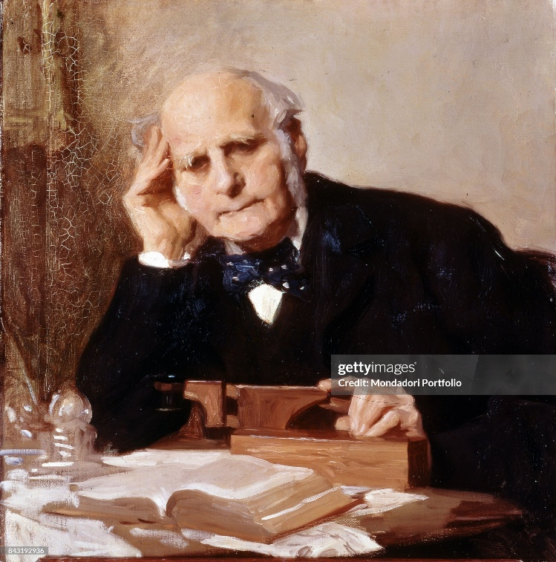
Regression Analysis
“It appeared from these experiments that the offspring did not tend to resemble their parents in size, but always to be more mediocre than they – to be smaller than the parents, if the parents were large; to be larger than the parents, if the parents were small.”
Sir Francis Galton

Slide 3
Prescribed Text Books
Montgomery, D. C., G.C. Runger, Applied Statistics and Probability for Engineers. 5th ed. New Delhi: Wiley-India, 2011.
Draper, N. R., H. Smith, Applied Regression Analysis. 3rd ed. New Delhi: Wiley-India, 1998.
Kutner, M. H., C. J. Nachtschiem, J. Netner, Applied Linear Regression Models. 4th ed. New Delhi: McGraw Hill, 2004.
Note: In case of any reference be inadvertently omitted, the error will be rectified if intimated

Slide 4
What is Meant by Regression?
A return to former state of existence
Reduced symptoms or lower severity of a disease instead of its progression (regression of disease)
The relation between input and output is called regression because it refers to a statistical tendency of data points to move ("regress" or "step back") towards the average (mean) value.

Slide 5
What is Meant by Regression?
Historical Origin: "Regression to the Mean"
Galton's Observations (1870s-1880s): While studying the inheritance of traits, Galton observed that children of very tall parents were usually shorter than their parents but taller than the average, while children of very short parents were usually taller than their parents but shorter than the average.

Slide 6
What is Meant by Regression?
Regressing Toward Mediocrity: Galton called this phenomenon "regression toward mediocrity" or "regression to the mean," meaning that data points extreme in value tend to "regress" back toward the average value.
The "Line of Regression": To visualize and model this, Galton used a straight line to summarize the relationship, which he termed the "regression line”
Machine Learning Definition: In modern data science, regression refers to a supervised learning technique used to predict a continuous numerical output (e.g., price, temperature, sales volume) based on input features.

Slide 7
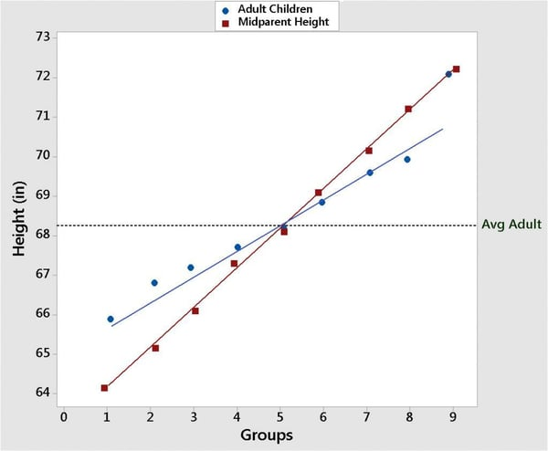
Which is mid-parent height and which is child height?
https://select-statistics.co.uk/blog/regression-to-the-mean-as-relevant-today-as-it-was-in-the-1900s/

Slide 9
The Regression Line of Galton
Regression to the mean is an important statistical phenomenon which is often neglected and may lead to misleading conclusions.
For example, statistics on the impact of CCTVs indicated that they reduced crime by around 100 robberies
This inference was based on the reduction in crime after the CCTVs had been installed.
But, CCTVs are often installed after there have been an unusually high number of robberies
So you may generally anticipate that the number of robberies return to normal levels afterwards anyway

Slide 10
Regression and Causality
Let there be a strong statistical relation between the response variable Y and the explanatory or predictor variable X
But it does not imply in any way that Y depends causally on X i.e., X was solely responsible for causing Y
Irrespective of the strong statistical relation between X and Y, do not attribute a cause-and-effect pattern to the regression model.

Slide 11

What is Linear about Regression?
In linear regression, "linear" means the model is linear in its parameters (β_{o}, β₁, … )
This means that the parameters are not multiplied, divided, or raised to powers, allowing the model to be expressed as a weighted sum:

Slide 12
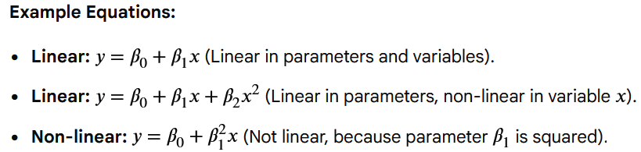
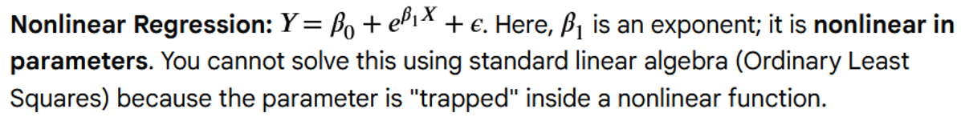
What is Linear about Regression?
+ ε
)+ ε
)+ ε

Slide 13
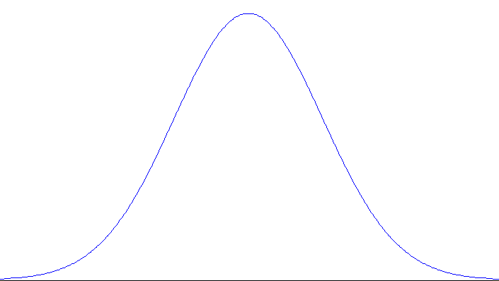
N(β₀+β₁X, σ²)
Y
True line
Y = β₀+β₁X
X

Slide 15
Overall Summary of Regression
Regression model assumes that the probability distributions of Y have the same variance σ², regardless of the level of the predictor variable X.
The error terms are assumed to be uncorrelated.
Since the error terms ε_{i} and ε_{j} are uncorrelated, so are the responses Y_{i} and Y_{j}
Regression model implies that the responses Y_{i} come from probability distributions whose means are E(Y_{i}) = β₀ + β₁X_{i} and whose variances are σ², the same for all levels of X

Slide 16
Underlying Assumptions in Linear Regression
A1: Linearity in parameters
A2: The independent variables are measured without error
A3: Homoscedasticity: Error terms have a constant variance: Var(ε_{i}) = σ²
A5: The error terms ε_{i} are normally distributed: ε_{i} ∼ N(0, σ² )
A6: No perfect multi-collinearity
Notes:
It measures how a variable at time \(t\) relates to itself at a previous time \(t-k\) (where \(k\) is the lag). Unlike standard correlation which measures the relationship between two different variables, autocorrelation examines the internal structure of a single series.

Slide 17
Another Important Assumption
A0: Cov(ε_{i}, X_{ji}) = 0
In linear regression, this means that the error term (ε_{i}) is uncorrelated with the i^{th} setting of the independent variables (X_{j}).
This fundamental assumption, often called exogeneity, ensures that the independent variables do not explain the variance in the errors

Slide 18
Multiple Regression Model
Y = β_{o} + β₁X₁ + β₂X₂ + ε
Y : Response
X₁: independent variable 1
X₂: independent variable 2
ε : independent error term

Slide 19
Multiple Linear Regression Model
Y = β_{o} + β₁X₁ + β₂X₂ + ε
The term multiple appears because it contains more than one regressor variable and the term linear appears because the equation is a linear function of the unknown parameters β_{o}, β₁ and β₂.

Slide 20
Multiple Regression Model
Y = β_{o} + β₁X₁ + β₂X₂ + ε
β_{o} : Intercept
β₁: partial regression coefficient 1
β₂: partial regression coefficient 2

Slide 21
Partial Regression Coefficients
Y = β_{o} + β₁X₁ + β₂X₂ + ε
β₁ and β₂ : partial regression coefficients 1 and 2
The term partial is used because
β₁ refers to the change in the response Y due to a change only in X₁ with X₂ being kept constant.

Slide 22
Regression: Illustration
N(β₀+β₁X, σ²)
Y
True line
Y = β₀+β₁X
X

Slide 23
Partial Regression Coefficients
Each response is assumed to belong to a normal distribution centered vertically at the coordinate given by the regression line.
The variances of all the normal distributions are assumed to be the same.

Slide 24
Multiple Regression Model
Y = β_{o} + β₁X₁ + β₂X₂ +…+ β_{k}X_{k} + ε
This is a multiple regression model with k regressor variables (X₁, X₂, …, X_{k}).
The parameters β_{o}, β₁, β_{2, …,} β_{k} are called as partial regression coefficients.

Slide 25
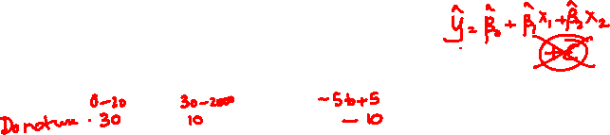
Multiple Regression Model
Y = β_{o} + β₁X₁ + β₂X₂ +…+ β_{k}X_{k} + ε
Even though the actual functional relationship between Y and X₁, X₂,…, X_{k} is unknown, the regression equation represents an approximate relationship between the two over a certain (narrow) range of the variables.

Slide 26
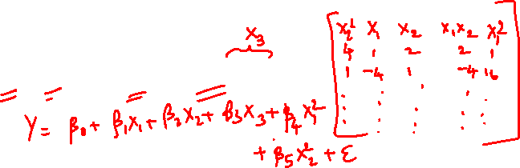
Multiple Regression Model
The Multiple Regression Model involving interaction between variables may represented by
Y = β_{o} + β₁X₁ + β₂X₂ +β₁₂X₁X₂ + ε

Slide 27
Multiple Regression Model
Y = β_{o} + β₁X₁ + β₂X₂ +β₁₂X₁X₂ + ε
This is still a linear regression model as the functional relationship is linear in the unknown parameters (β_{o}, β₁, β₂, β₁₂).

Slide 28
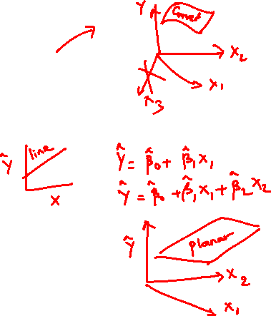
Multiple Regression Model
Y = β_{o} + β₁X₁ + β₂X₂ +β₁₂X₁X₂ + ε
Expressing X₁X₂ as equal to X₃ we may write the above equation as
Y = β_{o} + β₁X₁ + β₂X₂ +β₃X₃ + ε

Slide 29
Multiple Regression Model
When we generate a response surface to this model, we get a curved surface.
However this still remains a linear model as it is linear in its parameters (β_{o}, β₁, β₂, β₃)
Without interaction term, we have a flat planar surface

Slide 30
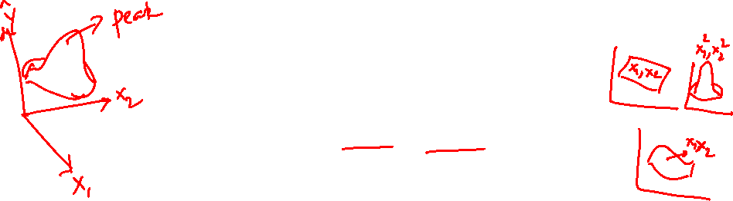
Multiple Regression Model
Y = β_{o} + β₁X₁ + β₂X₂ + β₁₁X₁² + β₂₂X₂² + β₁₂X₁X₂ + ε
Y = β_{o} + β₁X₁ + β₂X₂ + β₃X₃ + β₄X₄ + β₅X₅+ ε
Any regression model that is linear in parameters (βs) is a linear regression model, irrespective of the resulting response surface being a plane or curved. .

Slide 31
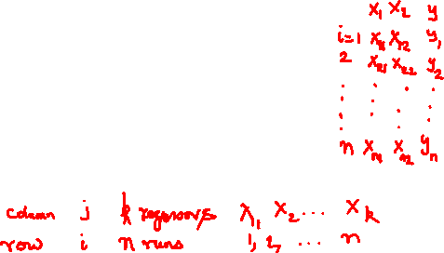
Matrix Approach to Multiple Regression
Let there be k regressor variables with n observations
(X_{i1}, X_{i2}, X_{i3},…, X_{ik}, Y_{i}), i=1, 2,…,n
Y_{i} = β_{o} + β₁X_{i1} + β₂X_{i2} + …+ β_{k}X_{ik} + ε_{i} i=1, 2,…, n
Note: n > k
This may be represented in a matrix notation as Y = Xβ+ ε

Slide 32
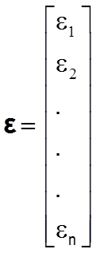
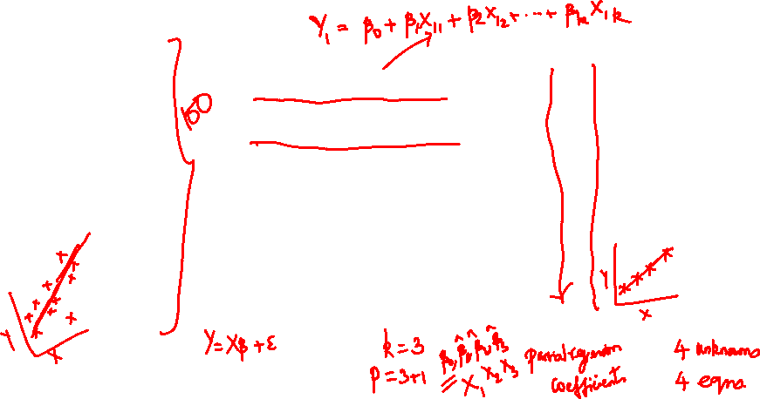
Matrix Form of the Regression Equations

Slide 33
Y is an (n x1) vector of the observations
X is an (n x p) matrix of the levels of the independent variables

Slide 34
β is a (px1) vector of the regression coefficients, and ε is a (nx1) vector of the random errors. Here p = k+1

Slide 35
Matrix Approach to Multiple Regression
Y = Xβ+ ε
We wish to find estimates for the linear regression model coefficients (also called parameters) which are expressed as follows

Slide 36
Matrix Approach to Multiple Regression
Using these coefficients in the following model will help us to predict the response for various values of X_{i} (i=1,2,…k)

Slide 37
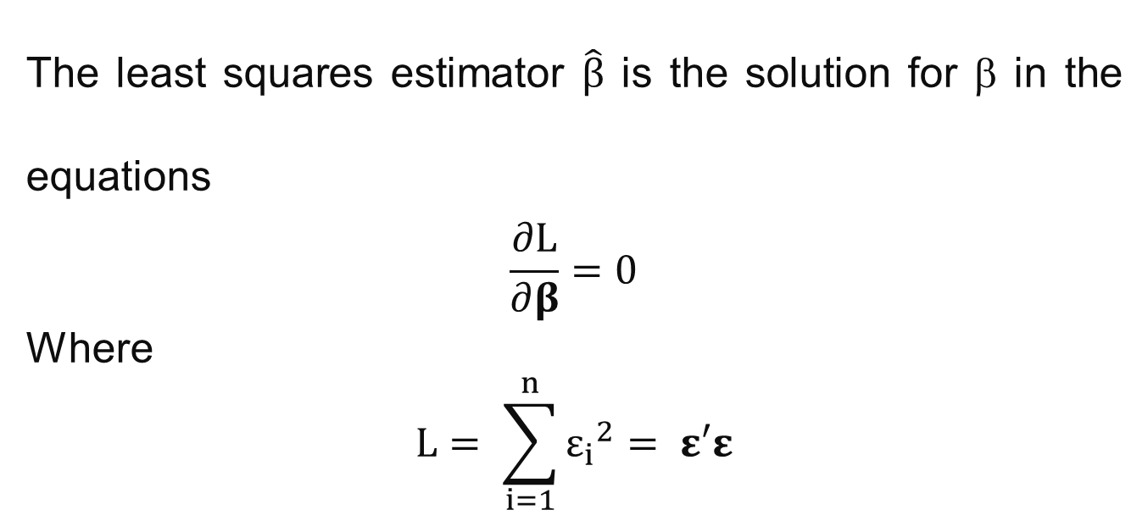
Least Squares Estimators of β
The least squares estimator $\hat{β}$ is the solution for β in the equations
$$\frac{∂L}{∂β}=0$$
Where
$$L= \sum_{i=1}^{n}{{ε_{i}}^{2}= ε′ε}$$

Slide 38
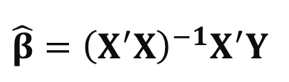
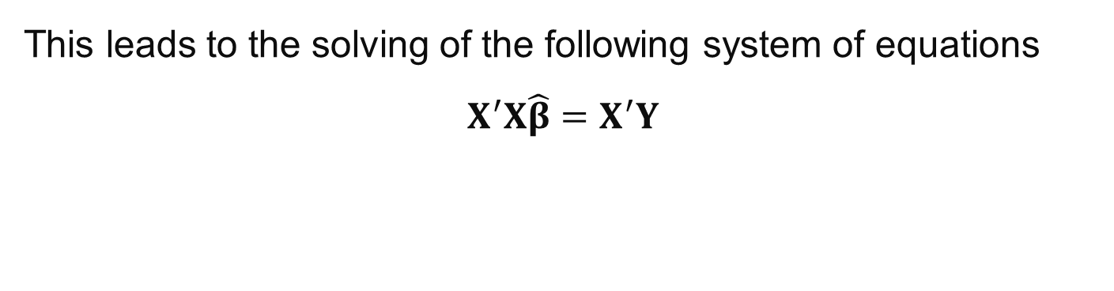
Least Squares Estimators of β
This leads to the solving of the following system of equations
$$X^{′}X\hat{β}=X^{′}Y$$
These are the least squares model equations in matrix form. Their solution is given by
$$\hat{β}={{\left(X^{′}X\right)}^{−1}X}^{′}Y$$

Slide 39
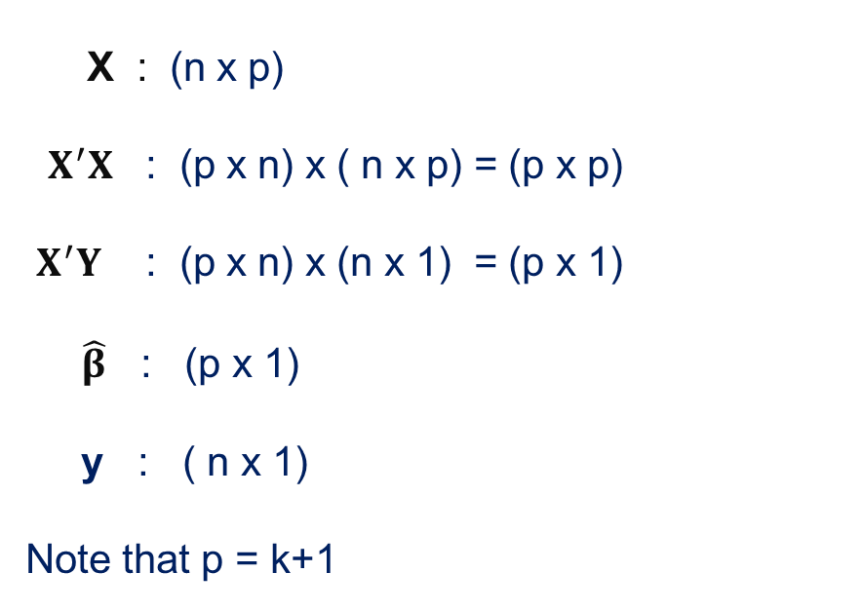
Dimensions of Matrices
X : (n x p)
$X^{′}X$ : (p x n) x ( n x p) = (p x p)
$X^{′}Y$ : (p x n) x (n x 1) = (p x 1)
$\hat{β}$ : (p x 1)
y : ( n x 1)
Note that p = k+1

Slide 40
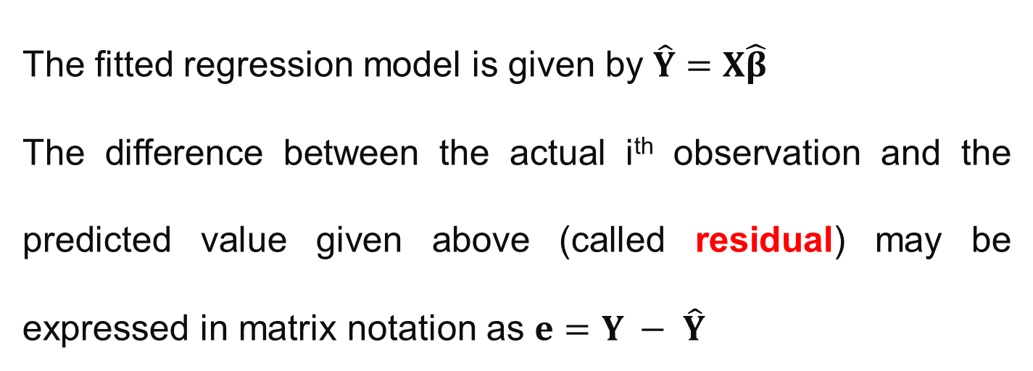
Dimensions of Matrices
The fitted regression model is given by $\hat{Y}=X\hat{β}$
The difference between the actual i^{th} observation and the predicted value given above (called residual) may be expressed in matrix notation as $e=Y − \hat{Y}$

Slide 41


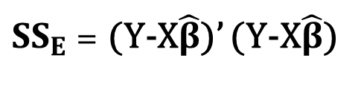
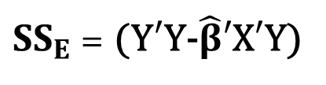
Calculations of Error Sum of Squares (SS_{E})
$$e=Y − \hat{Y}$$
$$e′=Y′ − \hat{Y}′$$
It may be shown that
${SS}_{E}$ = (Y-X$\hat{β}$)’ (Y-X$\hat{β}$)
${SS}_{E}$ = (Y$′$Y-$\hat{β}′$X$′$Y)

Slide 42
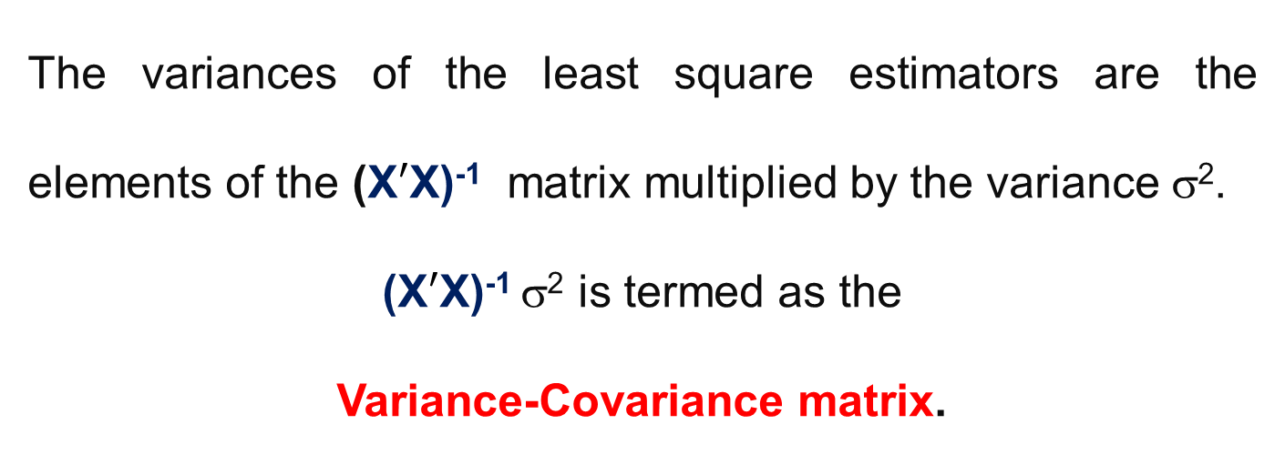
Variance-Covariance Matrix
The variances of the least square estimators are the elements of the (X$′$X)⁻¹ matrix multiplied by the variance σ².
(X$′$X)⁻¹ σ² is termed as the
Variance-Covariance matrix.

Slide 43
Variance-Covariance Matrix
The diagonal elements of the Covariance matrix are the variances of the least square estimators and the off-diagonal elements are the covariances.
The Covariance matrix dimensions are p x p

Slide 44
Matrix Form of the Regression Equations

Slide 45
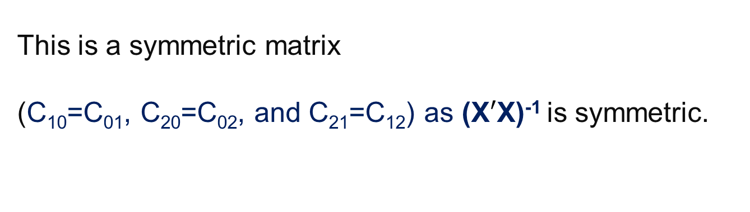
Matrix Form of the Regression Equations
This is a symmetric matrix
(C₁₀=C₀₁, C₂₀=C₀₂, and C₂₁=C₁₂) as (X$′$X)⁻¹ is symmetric.

Slide 46
Significance of the Covariance Matrix
Estimates of the variances of the regression coefficients may be obtained by substituting σ² with an estimate as σ² is unknown.

Slide 47
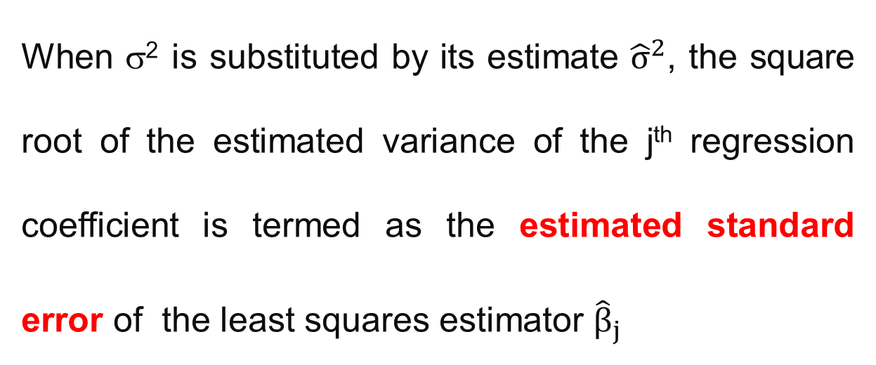
Estimated Standard Error
When σ² is substituted by its estimate ${\hat{σ}}^{2}$, the square root of the estimated variance of the j^{th} regression coefficient is termed as the estimated standard error of the least squares estimator ${\hat{β}}_{j}$

Slide 48
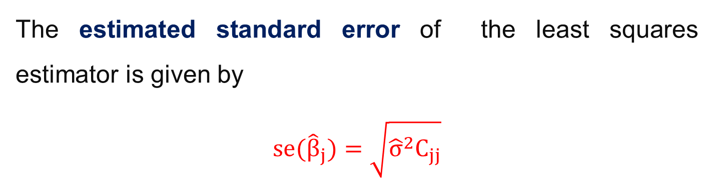
Estimated Standard Error
The estimated standard error of the least squares estimator is given by
$$se({\hat{β}}_{j})=\sqrt{{{\hat{σ}}^{2}C}_{jj}}$$

Slide 49
Estimated Standard Errors
These standard errors provide an idea of the precision of the estimation for the regression coefficients
Small standard errors indicate good precision.

Slide 50
Estimator of Error Variance
Estimation of residual error is important
The residual should ideally reflect the difference due to random factors and not systematic discrepancies created by using an inadequate model
This is an unbiased estimator of σ²

Slide 51
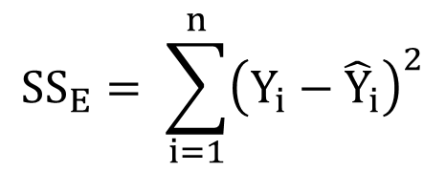
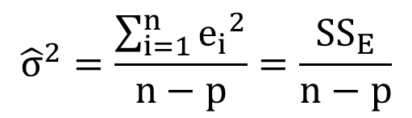
Estimator of Error Variance
$${\hat{σ}}^{2}=\frac{\sum_{i=1}^{n}{{e_{i}}^{2}}}{n−p}=\frac{{SS}_{E}}{n−p}$$
$${SS}_{E}= \sum_{i=1}^{n}{{\left(Y_{i}−{\hat{Y}}_{i}\right)}^{2}}$$

Slide 52

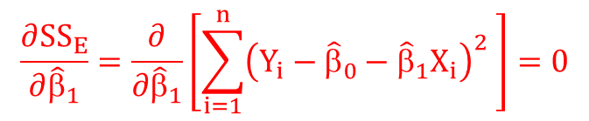
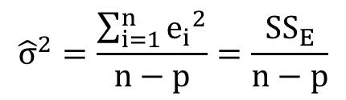

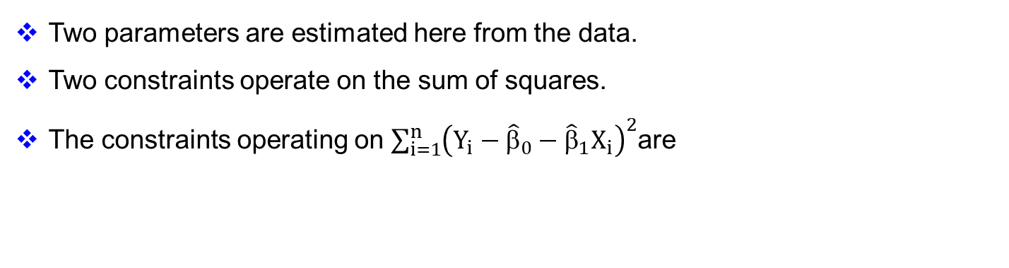
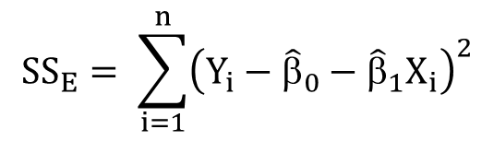
Why n-p?
$${SS}_{E}= \sum_{i=1}^{n}{{\left(Y_{i}−{\hat{Y}}_{i}\right)}^{2}}$$
$${\hat{σ}}^{2}=\frac{\sum_{i=1}^{n}{{e_{i}}^{2}}}{n−p}=\frac{{SS}_{E}}{n−p}$$
$${SS}_{E}= \sum_{i=1}^{n}{{\left(Y_{i}−{\hat{β}}_{0}−{\hat{β}}_{1}X_{i}\right)}^{2}}$$
Two parameters are estimated here from the data.
Two constraints operate on the sum of squares.
The constraints operating on $\sum_{i=1}^{n}{{\left(Y_{i}−{\hat{β}}_{0}−{\hat{β}}_{1}X_{i}\right)}^{2}}$are
$$\frac{∂{SS}_{E}}{∂{\hat{β}}_{0}}=\frac{∂}{∂{\hat{β}}_{0}}\left[\sum_{i=1}^{n}{{\left(Y_{i}−{\hat{β}}_{0}−{\hat{β}}_{1}X_{i}\right)}^{2} }\right]=0$$
$$\frac{∂{SS}_{E}}{∂{\hat{β}}_{1}}=\frac{∂}{∂{\hat{β}}_{1}}\left[\sum_{i=1}^{n}{{\left(Y_{i}−{\hat{β}}_{0}−{\hat{β}}_{1}X_{i}\right)}^{2} }\right]=0$$

Slide 53
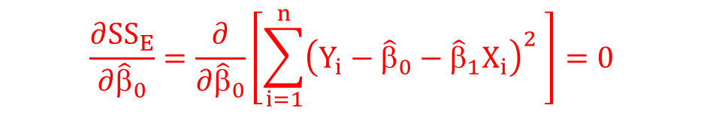
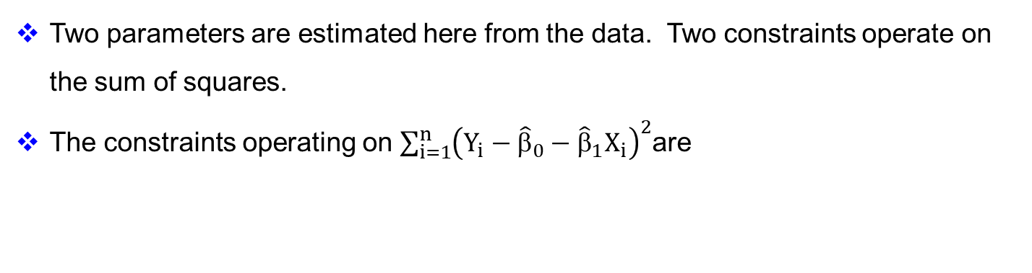
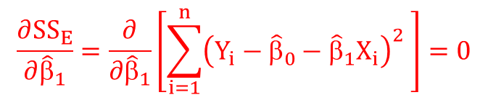
Why n-p?
Two parameters are estimated here from the data. Two constraints operate on the sum of squares.
The constraints operating on $\sum_{i=1}^{n}{{\left(Y_{i}−{\hat{β}}_{0}−{\hat{β}}_{1}X_{i}\right)}^{2}}$are
$$\frac{∂{SS}_{E}}{∂{\hat{β}}_{0}}=\frac{∂}{∂{\hat{β}}_{0}}\left[\sum_{i=1}^{n}{{\left(Y_{i}−{\hat{β}}_{0}−{\hat{β}}_{1}X_{i}\right)}^{2} }\right]=0$$
$$\frac{∂{SS}_{E}}{∂{\hat{β}}_{1}}=\frac{∂}{∂{\hat{β}}_{1}}\left[\sum_{i=1}^{n}{{\left(Y_{i}−{\hat{β}}_{0}−{\hat{β}}_{1}X_{i}\right)}^{2} }\right]=0$$

Slide 54
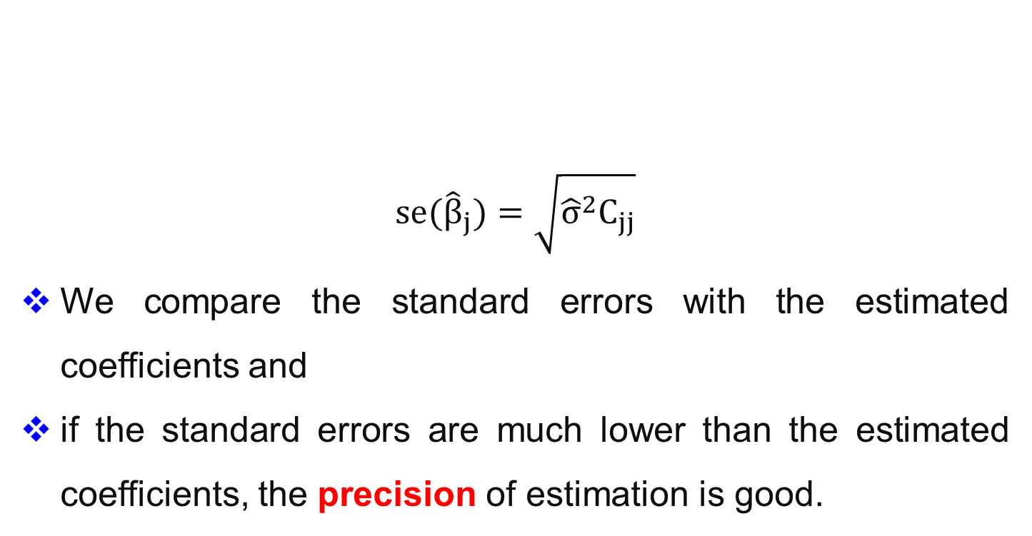
$$se({\hat{β}}_{j})=\sqrt{{{\hat{σ}}^{2}C}_{jj}}$$
We compare the standard errors with the estimated coefficients and
if the standard errors are much lower than the estimated coefficients, the precision of estimation is good.
Standard Error

Slide 55
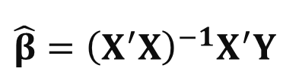
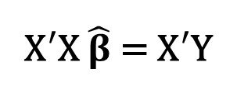
Statistical Properties of the Coefficients
The least squares model equations in matrix form is given below. The solution is given by
X$′$X $\hat{β}$ = X$′$Y
$$\hat{β}={{\left(X^{′}X\right)}^{−1}X}^{′}Y$$

Slide 56
Actual response and its prediction
Express the deviation between an actual response and the predicted response in terms of difference of two deviations
Deviation of actual response from mean response
Deviation of predicted response from mean response

Slide 57
Relation between actual response and its prediction
Deviation of actual response from mean response
Deviation of predicted response from mean response

Slide 58
(X_{i}, Y_{i})
Y_{i}
X_{i}

Slide 59
Sum of Squares in Linear Regression
Total Sum of Squares =
Regression Sum of Squares
+
Residual Sum of Squares
SS_{Total} = SS_{Regression} + SS_{Residual}

Slide 60

Resolution of Total Sum of Squares
The total sum of squares is given as usual by
$${SS}_{total}=\sum_{i=1}^{n}{{\left(Y_{i}−\overline{Y}\right)}^{2}}$$

Slide 61
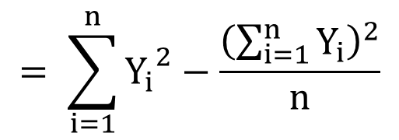
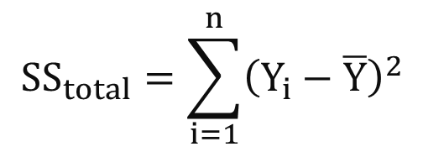
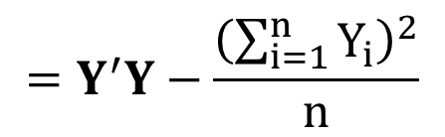
Resolution of Total Sum of Squares
$${SS}_{total}=\sum_{i=1}^{n}{{\left(Y_{i}−\overline{Y}\right)}^{2}}$$
$$= \sum_{i=1}^{n}{{Y_{i}}^{2}−\frac{{\left(\sum_{i=1}^{n}{Y_{i}}\right)}^{2}}{n}}$$
$$=Y^{′}Y−\frac{{\left(\sum_{i=1}^{n}{Y_{i}}\right)}^{2}}{n}$$

Slide 62
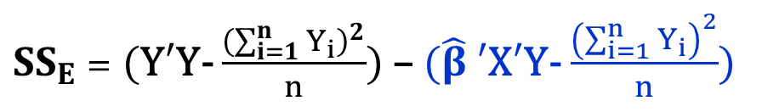
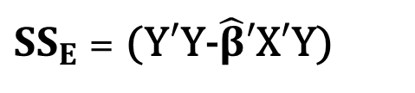
Resolution of Error Sum of Squares
${SS}_{E}$ = (Y$′$Y-$\hat{β}′$X$′$Y)
${SS}_{E}$ = (Y$′$Y- $\frac{{\left(\sum_{i=1}^{n}{Y_{i}}\right)}^{2}}{n}$) – ($\hat{β}$ $′$X$′$Y- $\frac{{\left(\sum_{i=1}^{n}{Y_{i}}\right)}^{2}}{n}$)
SS_{error} = SS_{total} – SS_{regression}
By definition of the total sum of squares, the second term becomes the regression sum of squares

Slide 63

Regression Sum of Squares due to β₀
Total Sum of Squares: $Y^{′}Y−\frac{{\left(\sum_{i=1}^{n}{Y_{i}}\right)}^{2}}{n}$
The actual total sum of squares is Y$′$Y.
The term $\frac{{\left(\sum_{i=1}^{n}{Y_{i}}\right)}^{2}}{n}$ is deducted from the total sum of squares.

Slide 64

Regression Sum of Squares due to β₀
Total Sum of Squares: $Y^{′}Y−\frac{{\left(\sum_{i=1}^{n}{Y_{i}}\right)}^{2}}{n}$
The regression sum of squares does not include the intercept β₀ contribution and has contributions only from β₁, β₂, β₃, … β_{k}

Slide 65

Regression Sum of Squares due to β₀
The contribution to the sum of squares due to β₀ is $\frac{{\left(\sum_{i=1}^{n}{Y_{i}}\right)}^{2}}{n}=n{\overline{Y}}^{2}$

Slide 66

Regression Sum of Squares due to β₀
Another way of looking at this is as follows
If we fit a model containing only β₀ , the fitted model is
$$\hat{Y}=\overline{Y}$$
or
$$β_{o}= \overline{Y}$$

Slide 67
Regression Sum of Squares due to β₀
When we do sum of squares analysis we first consider the contribution from the intercept (β₀) and then consider the additional contribution from the remaining regression coefficients for e.g. the slope (β₁) and so on.

Slide 68
Regression Analysis: A Few Terms Explained

Slide 69
Coefficient of Determination (R²):
This represents the proportion of the total variability accounted or explained by the linear regression model

Slide 70
Coefficient of Determination (R²):
The R² value may be increased by increasing the number of terms in the model and thereby increasing the number of coefficients that may be adjusted so that the model can be made to fit the data excellently.

Slide 71
Coefficient of Determination (R²):
A complex model becomes cumbersome to handle, more empirical in nature and difficult to ascribe physical reasons for the dependence of the response on the factors of the experiment.
A noisy data fitted with too many parameters will fail to work well when implemented.

Slide 72
Adjusted R²:
Here Mean Squares of the error and model/total sum of squares are used.

Slide 73
Adjusted R²:
To penalize the addition of unnecessary terms in the model equation (“overfitting”) the adjusted R² value also gets reported.

Slide 74
Adjusted R²:
The SS_{Error} contribution is increased by dividing with the error degrees of freedom. The latter reduces when more number of parameters are taken up by the model.

Slide 75
Adjusted R²:
Unless the SS_{Error} is considerably reduced by adding the extra term to the model equation, the adjusted R² will increase upon increasing the number of parameters.

Slide 76
PRESS: Prediction Error Sum of Squares
This term is also similar to the sum of squares of the residuals.
We sum the square of the deviations between the actual responses and the corresponding model predicted values.

Slide 77
PRESS: Prediction Error Sum of Squares
The main difference to watch out for is that the prediction for the i^{th} data is based on a model equation that excluded that particular data point but used the remaining data points to develop the model equation.

Slide 78
PRESS: Prediction Error Sum of Squares
The same treatment is meted to other data points as well when they are compared to their individual model predictions.

Slide 79
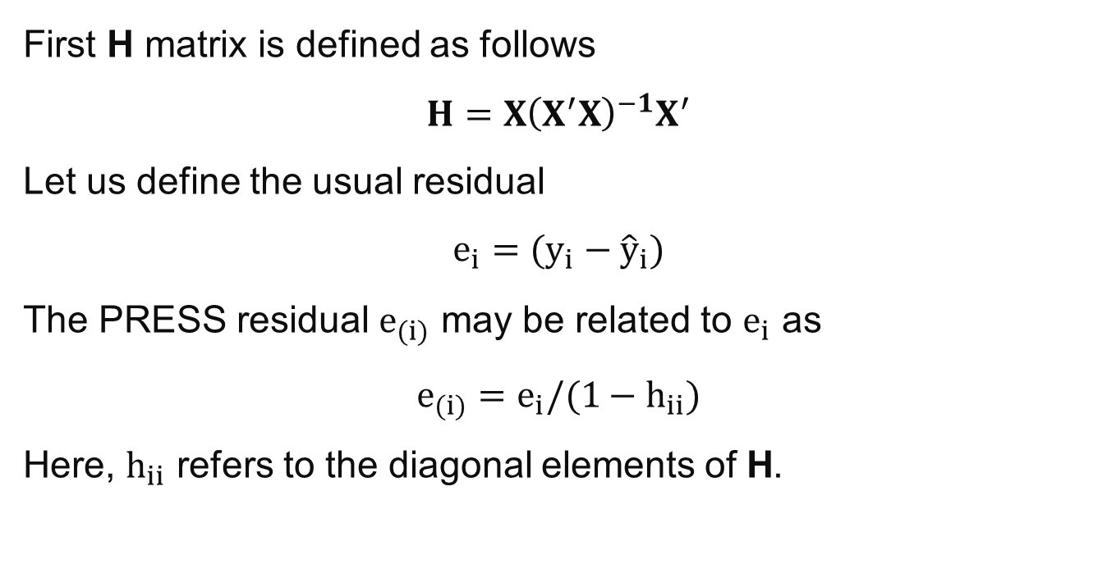
PRESS:
First H matrix is defined as follows
$$H={X\left(X^{′}X\right)}^{−1}X^{′}$$
Let us define the usual residual
$$e_{i}=(y_{i}−{\hat{y}}_{i})$$
The PRESS residual $e_{(i)}$ may be related to $e_{i}$ as
$$e_{(i)}=e_{i}/(1−h_{ii})$$
Here, $h_{ii}$ refers to the diagonal elements of H.

Slide 80
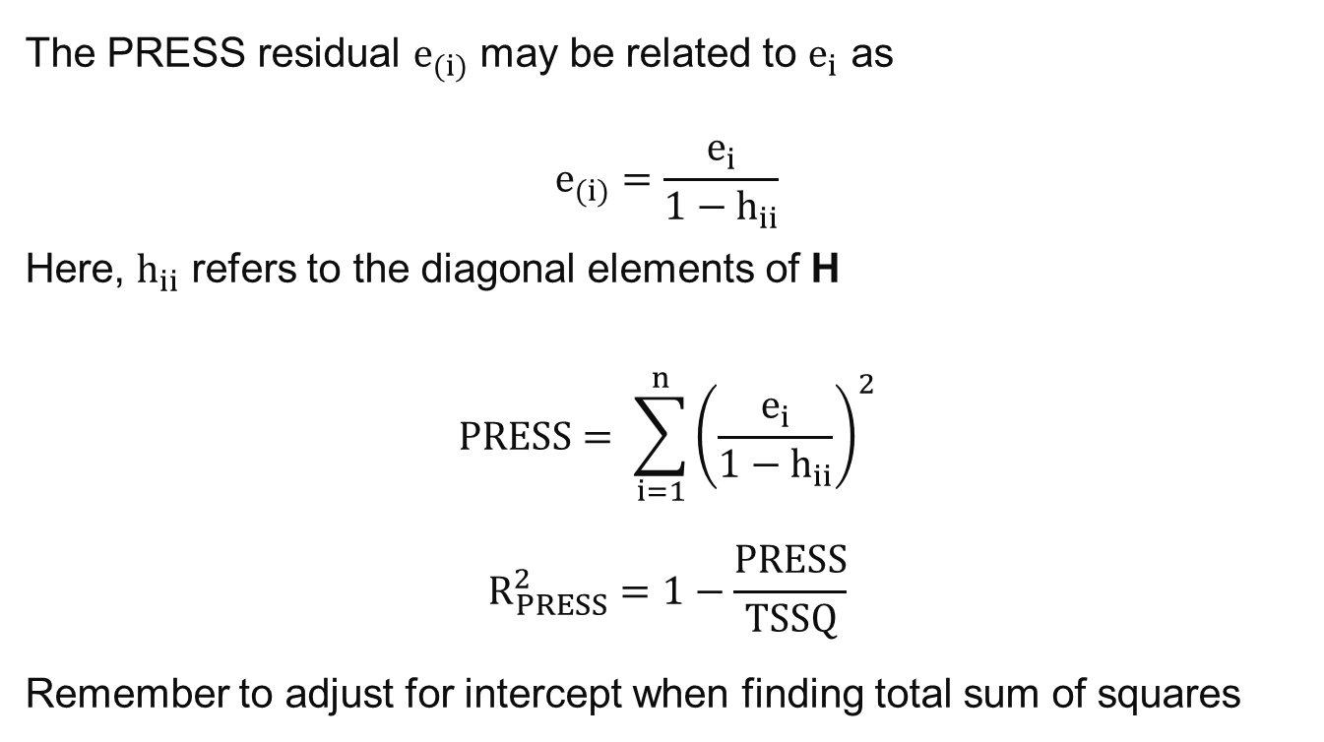
PRESS:
The PRESS residual $e_{(i)}$ may be related to $e_{i}$ as
$$e_{(i)}=\frac{e_{i}}{1−h_{ii}}$$
Here, $h_{ii}$ refers to the diagonal elements of H
$$PRESS= \sum_{i=1}^{n}{{\left(\frac{e_{i}}{1−h_{ii}}\right)}^{2}}$$
$$R_{PRESS}^{2}=1−\frac{PRESS}{TSSQ}$$
Remember to adjust for intercept when finding total sum of squares

Slide 81
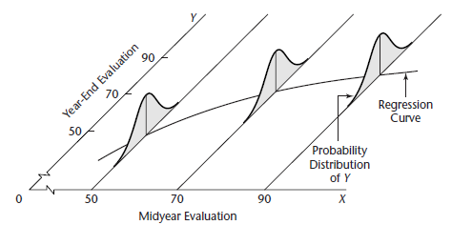
Representation of Regression
Figure also shows probability distributions of Y for midyear evaluation levels X = 50 and X = 70
Means of the probability distributions have a systematic relation to the level of X.
This systematic relationship is called the regression function of Y on X
Graph of the regression function is the regression curve
The regression function is slightly curvilinear
Increase in the expected (mean) year-end evaluation with an increase in midyear performance evaluation is retarded at higher levels of midyear performance.

Slide 82
Degrees of Freedom
SS_{Total} = SS_{Regression} + SS_{Residual}
The SS_{Total} has n-1 degrees of freedom
The SS_{Regression} has k degrees of freedom where k is related to total number of regression coefficients as

Slide 83
Degrees of Freedom
p=k+1
The residual sum of squares has (n-p) degrees of freedom where n is total number of responses.

Slide 84
Analysis of Variance (ANOVA)
Source of Variation | Sum of Squares | Degrees of Freedom | Mean Square
Regression | SS_{R} | k | MS_{R}
Error or Residual | SS_{E} | n-p | MS_{E}
Total | SS_{T} | n-1

Slide 85
Source of Variation | Sum of Squares | Degrees of Freedom | Mean Square
Regression | SS_{R} | k | MS_{R}
Error or Residual | SS_{E} | n-p | MS_{E}
Total | SS_{T} | n-1
Here n is the total number of observations and p is the total number of parameters (including the constant β_{o}).
Since k = (n-1) – (n-p)
k = p-1

